Slide 1

IELTS Band Scores Explained
What the Numbers Really Mean
Notes:
NOTE:
“Hello, my name is April Ampong, and I’m an instructor at IELTS NINER REVIEW CENTER— an international-standard IELTS training system that helps learners progress from beginner level to Band 7.0–9.0 in the most time-efficient way.”
“Is Band 6 good enough? Is Band 7 really hard? And what does Band 8 actually mean in real life?”
“Many IELTS candidates focus only on the final number, without understanding what that number represents—and that’s why progress is often slow.”
“In this video, I’ll explain IELTS band scores clearly, so you know exactly where you are and what you need to improve.”

Slide 2
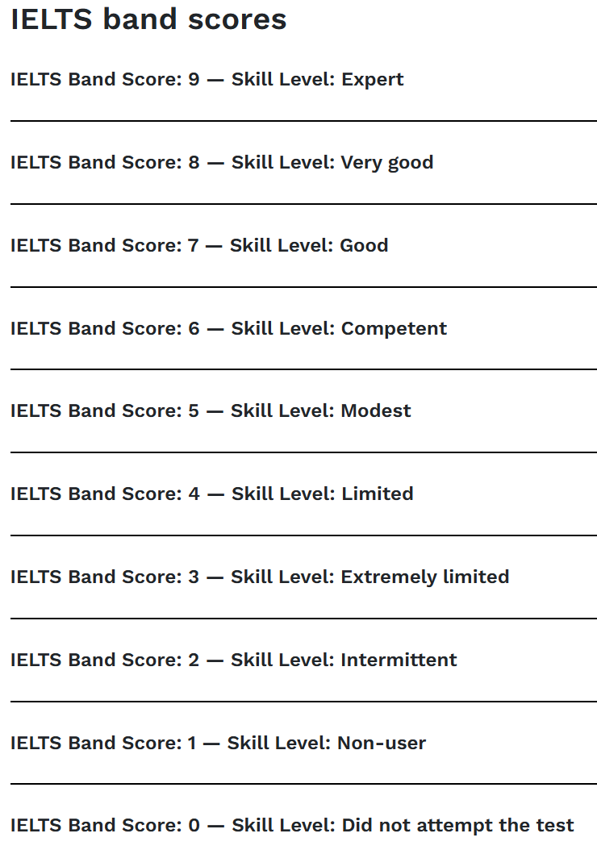
The IELTS Band Scale
IELTS uses a 9-band scoring system, from Band 1 to Band 9.
Each band represents a level of English ability, not a percentage score.
You receive:
A band score for each skill
And one overall band score
Notes:
In the previous video, we learned how to choose between IELTS Academic and IELTS General Training.”
“Once you’ve chosen the right test, the next step is understanding IELTS band scores—because your entire study plan depends on this.”
“So, how does IELTS scoring work? IELTS uses a 9-band scoring system, from Band 1 to Band 9. Each band represents a level of English ability—it’s not a percentage score, and it’s not about passing or failing. After the test, you’ll receive a separate band score for each skill: Listening, Reading, Writing, and Speaking. Then, all of these are combined to give you one overall band score. This overall score shows your general level of English and is the score universities, employers, and immigration offices usually look at.”

Slide 3
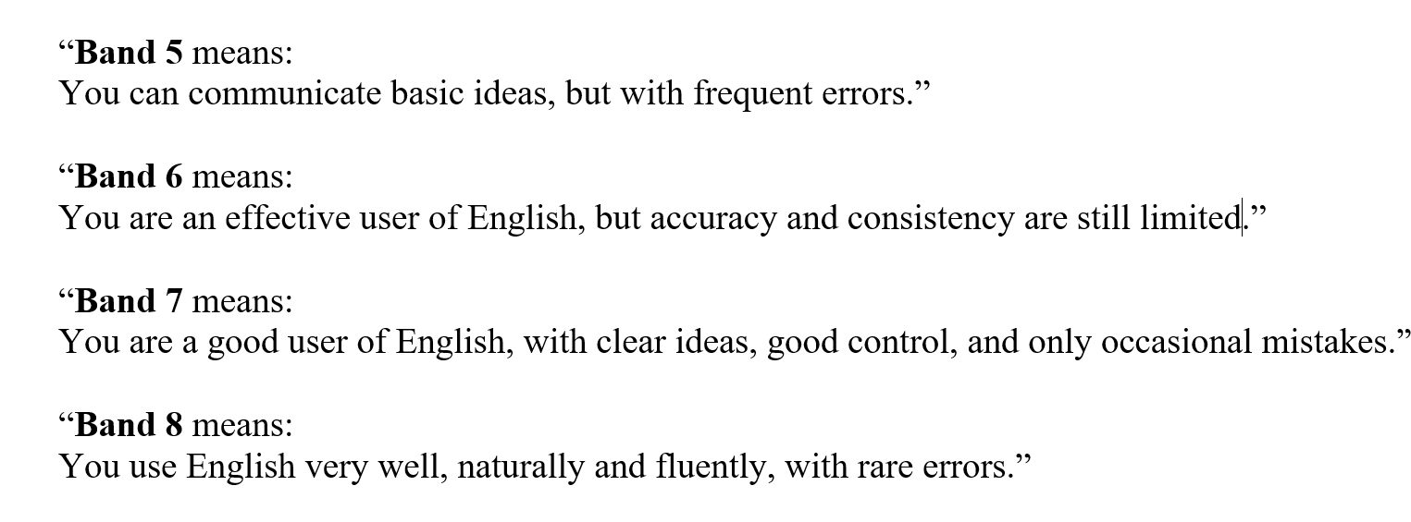
What Common Bands Mean
Notes:
“Let us now take a closer look at what common IELTS band scores actually represent. These are the band levels that most candidates aim for, depending on their academic, professional, or immigration goals.
Beginning with Band 5: A Band 5 score indicates that the candidate is able to communicate basic ideas in English. However, frequent grammatical and lexical errors are evident, and language control is limited. Although the general meaning is usually understandable, inaccuracies may sometimes affect clarity, particularly in more complex situations.
Moving on to Band 6: A Band 6 score describes an effective user of English. At this level, the candidate can communicate competently in most everyday and academic contexts. Nevertheless, accuracy and consistency are not yet fully developed, and errors may increase when the language demands become more challenging.
Next is Band 7: A Band 7 score reflects a good user of English. The candidate is able to express ideas clearly and logically, with a strong level of control over grammar and vocabulary. Errors occur only occasionally and rarely interfere with communication. This band score is commonly required by universities, professional bodies, and employers.
Then we have Band 8: A Band 8 score represents a very good user of English. Language use at this level is fluent, natural, and highly accurate. The candidate can handle complex language structures with confidence, and errors are rare and minor.
It is important to emphasise that progression between IELTS band scores is not determined simply by vocabulary size. Rather, higher bands reflect greater accuracy, consistency, and control over the language, as well as the ability to use English effectively in a wide range of situations.”

Slide 4
How the Overall Band Score Is Calculated
Your overall IELTS band score is the average of your four skills: Listening, Reading, Writing, and Speaking.”
The average is then rounded to the nearest half band
For example:
6.25 becomes 6.5
6.75 becomes 7.0
This means every skill matters—one weak skill can hold back your overall score.”
Notes:
Your overall IELTS band score is calculated by taking the average of your four individual skill scores: Listening, Reading, Writing, and Speaking. This average score is then rounded to the nearest half band.
For example, an average score of 6.25 is rounded up to 6.5, while an average of 6.75 is rounded up to a Band 7.0.
This scoring method highlights an important point: Every skill contributes equally to your final result. As a result, a weaker performance in one skill can significantly affect your overall band score, even if your other skills are strong.
For this reason, balanced preparation across all four skills is essential in order to achieve your target IELTS band score.”

Slide 5
A Critical Truth About Band Scores
Here’s a truth many candidates don’t realize.
IELTS does not compare you with other test takers. You are not competing against anyone.
You are measured against band descriptors—official criteria that describe performance at each band.”
That means: If you meet the criteria, you get the band—regardless of how others perform.
Notes:
“Here is an important truth that many IELTS candidates do not fully realise. IELTS is not a competitive exam, and it does not rank candidates against one another. You are not competing with other test takers sitting the exam on the same day.
Instead, IELTS is a standards-based assessment. Your performance is measured against official IELTS band descriptors— these are detailed criteria published by the test makers that describe what performance looks like at each band level for every skill.
Examiners use these band descriptors to assess your Listening, Reading, Writing, and Speaking independently. They evaluate factors such as task achievement, coherence, grammatical range and accuracy, vocabulary use, fluency, and pronunciation— not how well or how poorly other candidates perform.
This means that if your performance clearly meets the criteria for a particular band score, you will receive that band, regardless of how many other candidates score higher or lower than you.
Understanding this point is crucial for effective preparation. Success in IELTS is not about outperforming others, but about meeting the specific requirements of your target band. By focusing on the official band descriptors and developing consistent, controlled language use across all skills, candidates can approach the test with greater confidence and a clearer strategy.”

Slide 6
OUR APPROACH AT IELTS NINER REVIEW CENTER
We identify
Your current band level
The exact criteria you are missing
The fastest path to the next band
Notes:
“At IELTS NINER Review Center, we never tell students to ‘just study harder.’
Because improvement doesn’t come from effort alone—it comes from strategy.
Instead, we take a different approach. We identify your current band level, pinpoint the exact IELTS criteria you’re missing, and map out the fastest, most effective path to your next band score.
This is not guesswork. This is targeted training, based on how IELTS is truly assessed.
That’s how real improvement happens. That’s the IELTS NINER difference.”
“Now you understand what IELTS band scores mean.”
“But here’s the next crucial question:
How do examiners actually decide your band score?”
“In the next video, we’ll break down IELTS band descriptors—the exact marking criteria used by examiners.”
“See you in the next video.”

Slide 7
Add a Slide Title - 1

Slide 8
Add a Slide Title - 2

Slide 9
Add a Slide Title - 3

Slide 10
Add a Slide Title - 4

Slide 12
Add a Slide Title - 5

